Slide 1


The University as a Cloud: Openness in Education
Dr. Charles Severance
University of Michigan School of Information
www.dr-chuck.com

Slide 2
WARNING WARNING
This presentation does not contain facts or precise data. It is ideas, interpretations, imagination, paranoia, and guesses. The material is presented with simplification or exaggeration to make you think. Making you think is the goal of this presention.

Slide 3


Boundaries
Edges
Inside
Outside

Slide 4

Messages in
Architecture

Slide 5
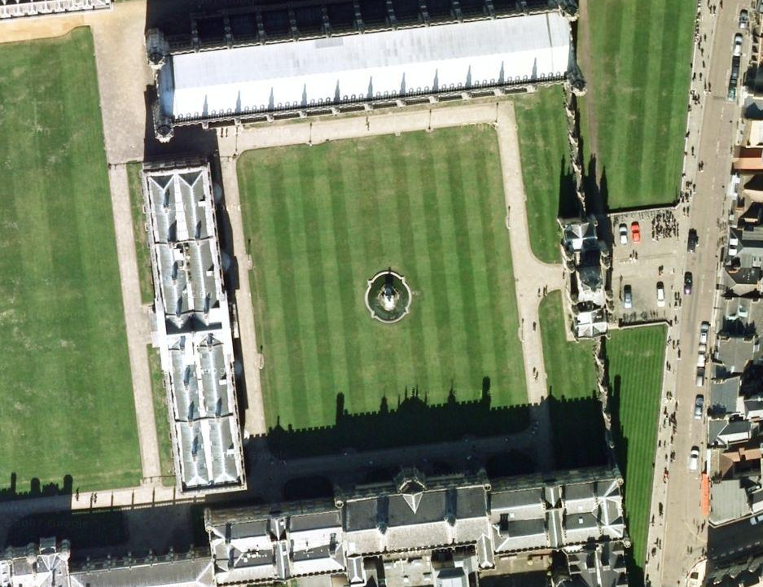
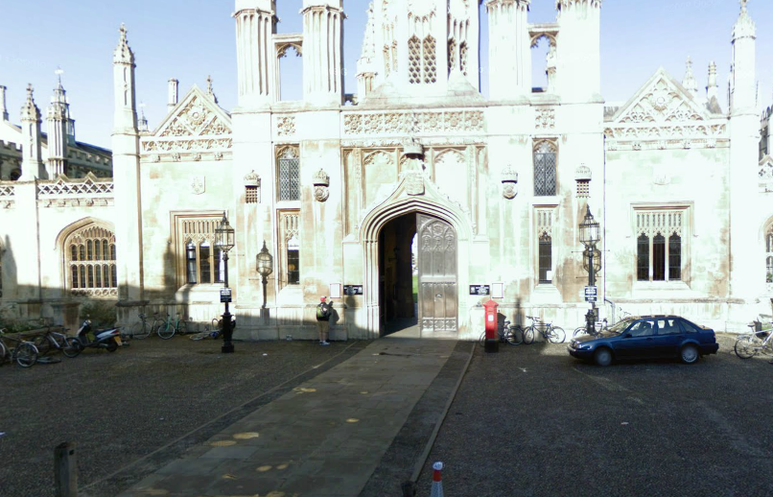
Kings College, Cambridge, 1444

Slide 6
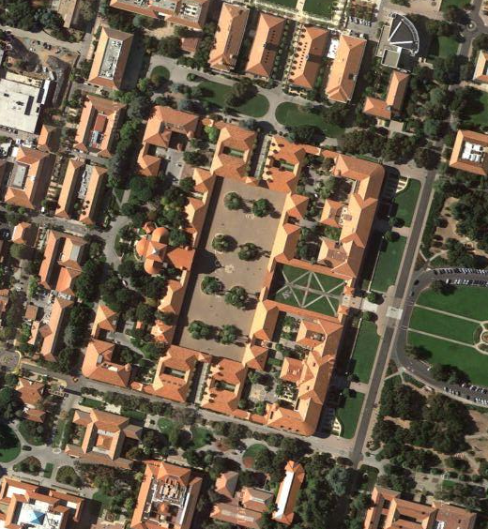
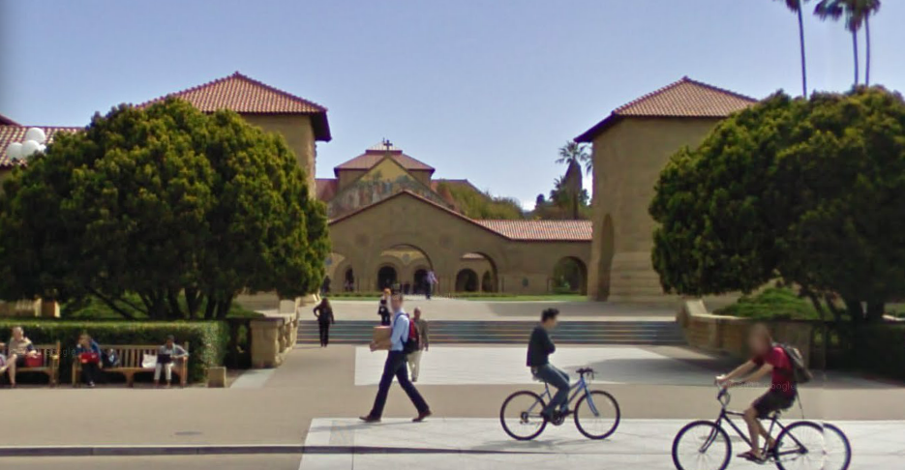
Stanford University Quad 1887

Slide 7
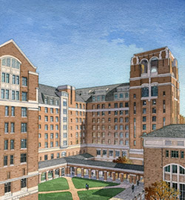
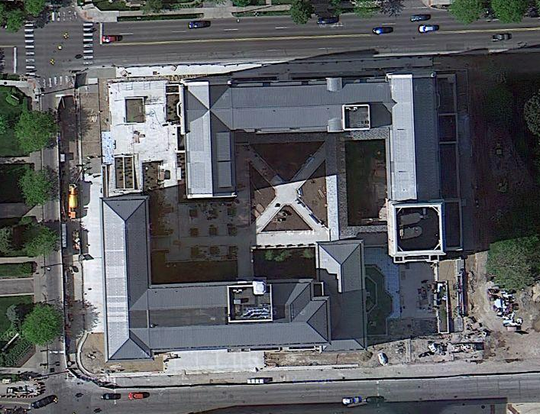
University of Michigan North Quad 2010

Slide 8
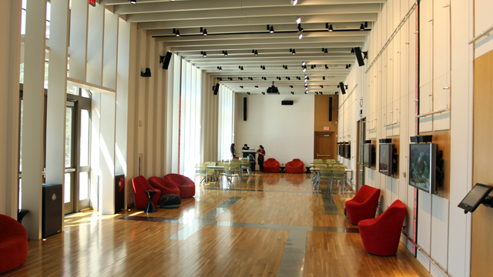
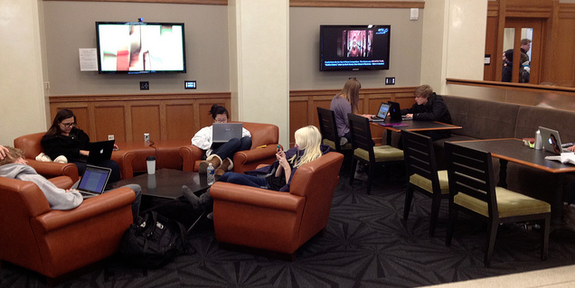
University of Michigan North Quad 2010
Notes:
Inside, outside, encouraged interaction at the boundaries.

Slide 9
Freedom for Academic Ideas

Slide 10
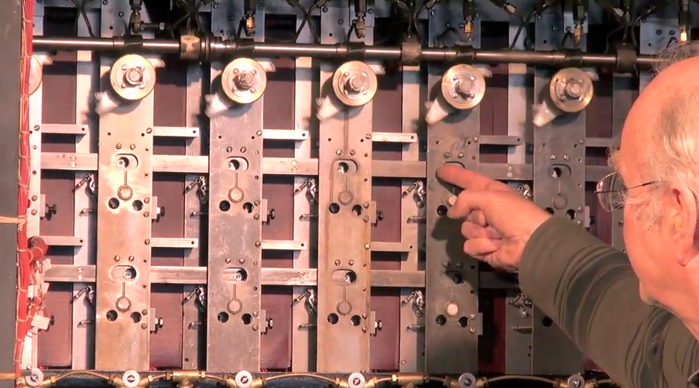
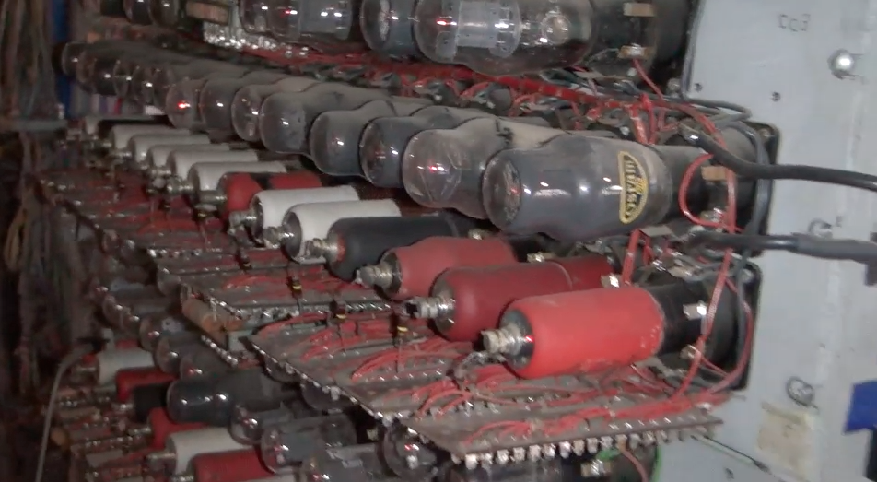
Alan Turing and Bletchley Park
Top secret code breaking effort
10,000 people at the peak (team effort)
BOMBE: Mechanical Computer
Colossus: Electronic Computer
http://www.youtube.com/watch?v=5nK_ft0Lf1s

Slide 11
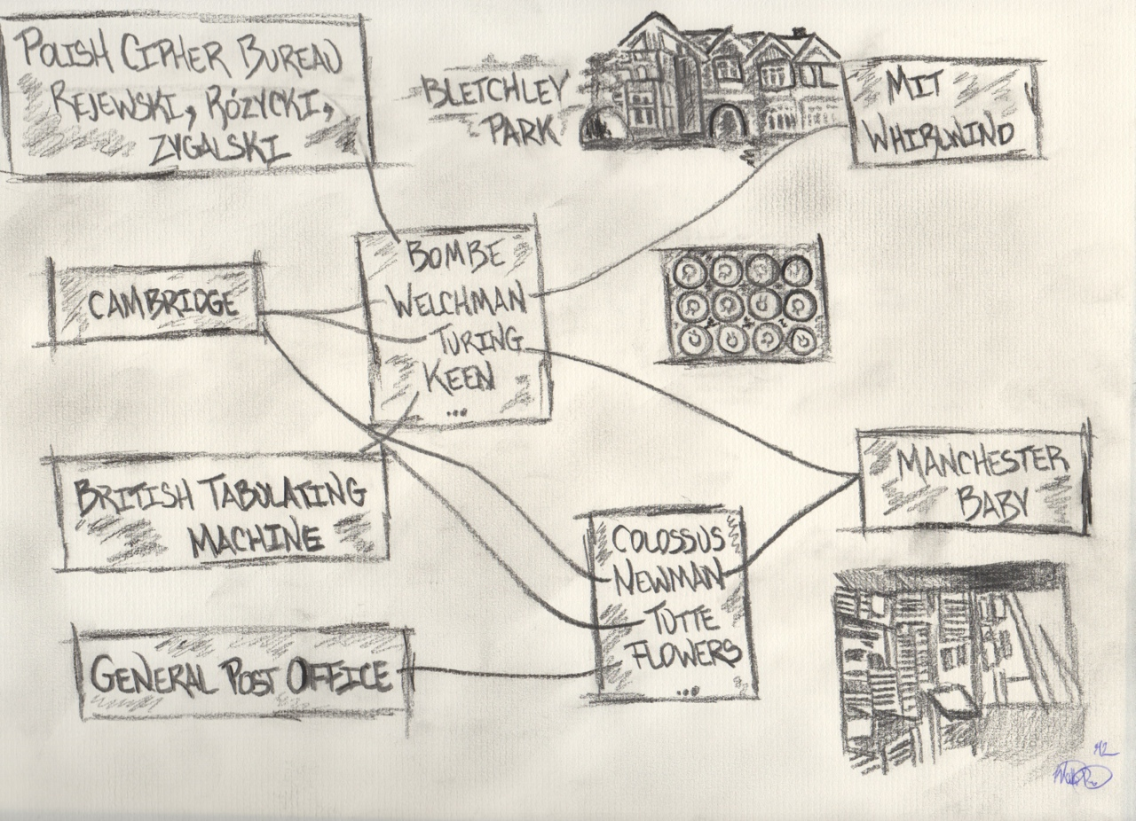
24:50
Graphic: Matt Pinter

Slide 12
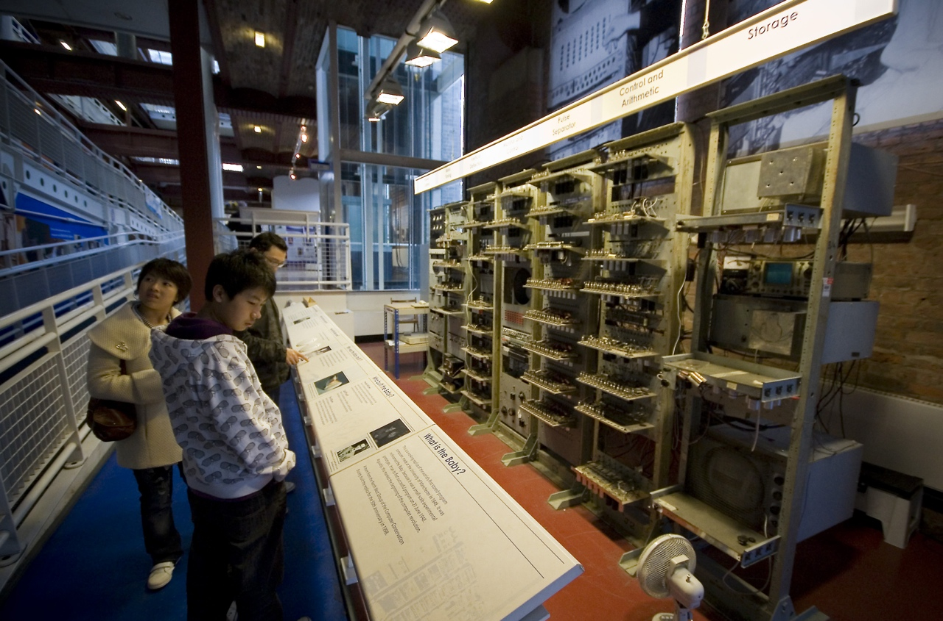
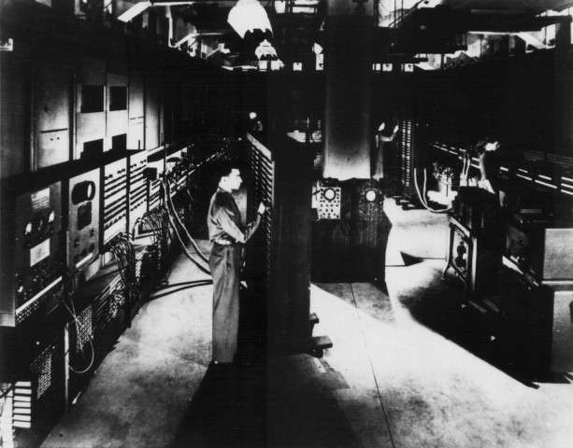
Post-War (1940s)
Alumni of the US and UK codebreaking efforts and other started building general purpose computers
Manchester Baby
Ferranti Mark I
Harvard Mark I
US Army ENIAC
http://upload.wikimedia.org/wikipedia/commons/b/bb/SSEM_Manchester_museum.jpg
http://en.wikipedia.org/wiki/File:Classic_shot_of_the_ENIAC.jpg

Slide 13
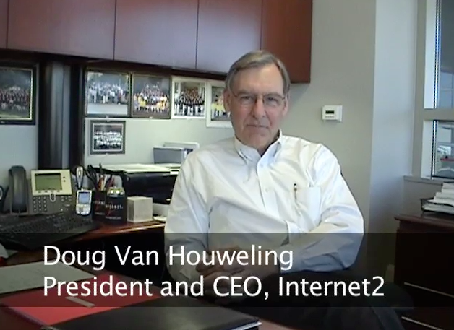
NSFNet @ University of Michigan
University of Michigan did not get a Supercomputer Center
Proposed a $55M high-speed network for $15M
Partners: University of Michigan, Merit Network, IBM Corporation, MCI, and State of Michigan
Operated from 1988-1995
http://www.vimeo.com/11044819
13:14

Slide 14
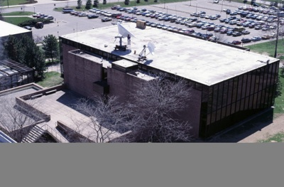
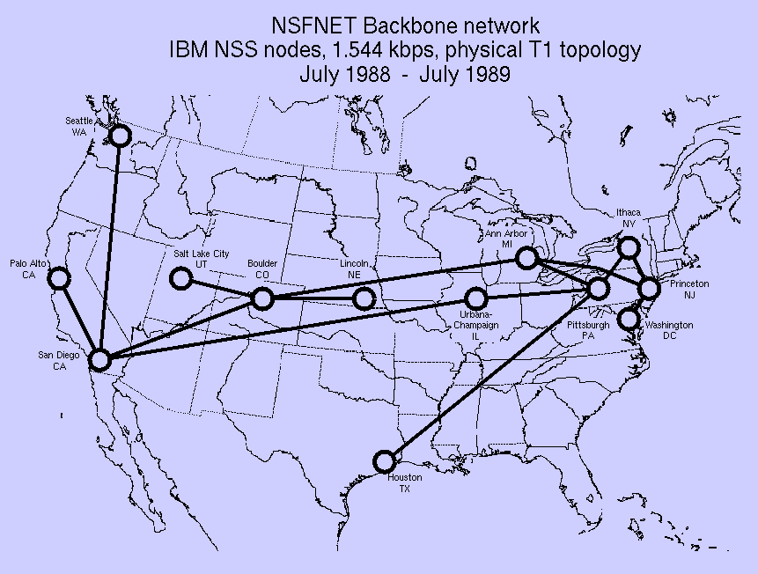
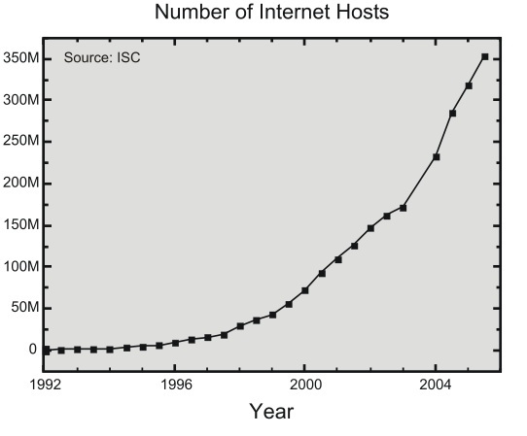
Source: http://hpwren.ucsd.edu/~hwb/NSFNET/NSFNET-200711Summary/
Notes:
Copyright folks: Do not replace the picture in the upper left of this slide.

Slide 15
NSF Net Advocacy
Initially aimed at research universities
Cleveland FreeNet and similar efforts provided indirect Internet access to the average citizen
In about 1989-1990, the "academic-only" started being relaxed - led to Internet Service Providers making "dial-up Internet" available to the general public

Slide 16
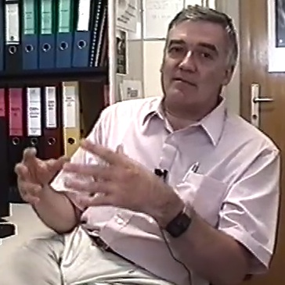
The Beginning of the Web: CERN
The Internet was infrastructure - the web gave the Internet a “user interface and URLs
The Web was invented at CERN by Tim Berners-Lee and Robert Cailliau
CERN developed browsers and servers - with a goal of worldwide hyperlinked documents
Robert Cailliau
CERN
(9:42)
http://www.youtube.com/watch?v=x2GylLq59rI

Slide 17
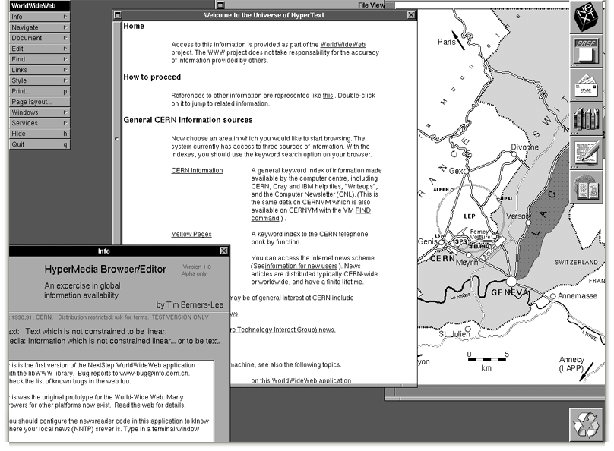
http://info.cern.ch/images/NextEditorBW.gif

Slide 18
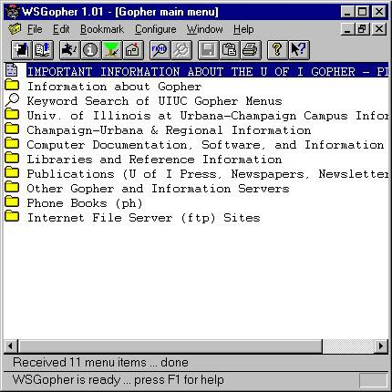
1993: Gopher is Dominant
Internet Engineering Task Force (IETF) Meeting
March 29-April 2, 1993 - Columbus, Ohio, USA (638 attendees)
Gopher BOF - 200 attendees
World-Wide Web BOF - 15 attendees including Tim Berners-Lee
P.S. DVD is invented this year
http://www.ietf.org/proceedings/26.pdf

Slide 19
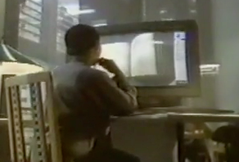
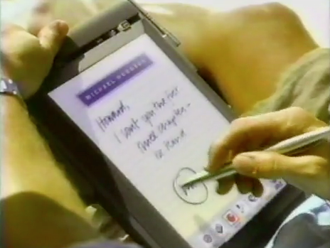
What industry was thinking in 1993...
http://www.youtube.com/watch?v=sYNUcFMCIzw
0:30

Slide 20
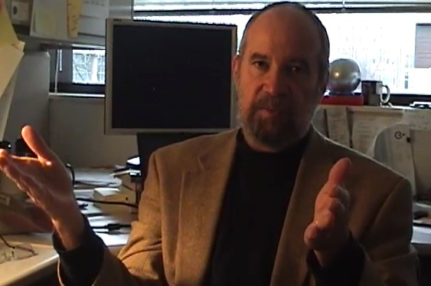
Mosaic - Netscape - Mozilla - Firefox
Mosaic was the first “consumer” web browser developed at NCSA
NCSA created the httpd web server which is the basic for the Apache web server
While most of the NCSA programmers formed Netscape and made their fortunes, NCSA released their browser for free and focused on building standards to keep the web open
Joseph Hardin, UM
http://www.vimeo.com/7053726
9:01

Slide 21
1994: Year of the Web
Netscape Founded - April 4, 1994
WWW Conf: May 25-26-27 1994, CERN, Geneva (Switzerland)
WWW Conf: October 17-19, 1994, Chicago, IL
October 1994, Tim Berners-Lee founded the (W3C) at MIT
November 8, 1994 - Windows 95 beta 2 - With a vengance!

Slide 22
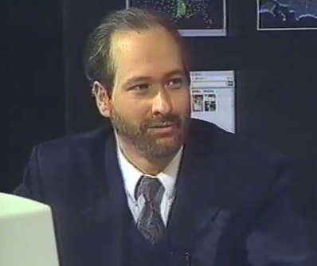
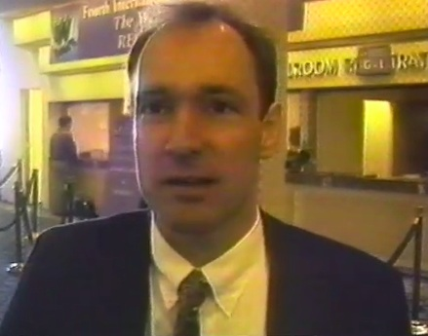
When You Can Assume the Web
Internet: TCI Show 08
http://www.vimeo.com/4275919
December 11-14, 1995
http://www.w3.org/Conferences/WWW4/
1:22

Slide 23
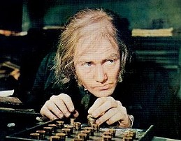
The Past

Slide 24
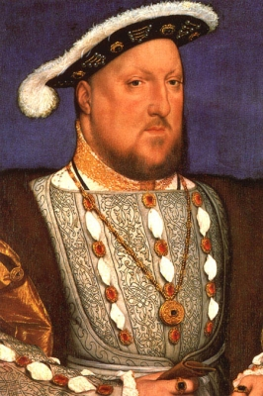
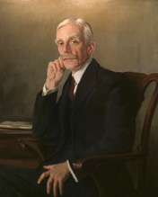
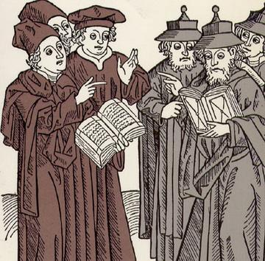
Education for the Wealthy Few
0000-1930
Graduates
Research / Ideas
Graduates
Gifts
Basic Funds
Gifts
Basic Funds

Slide 25
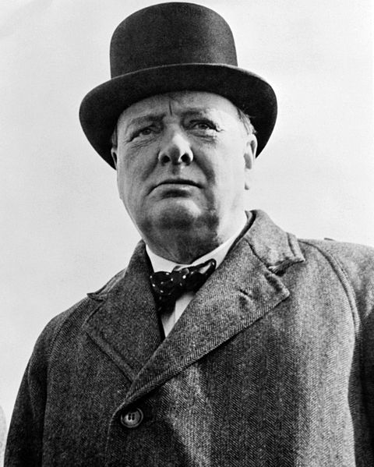


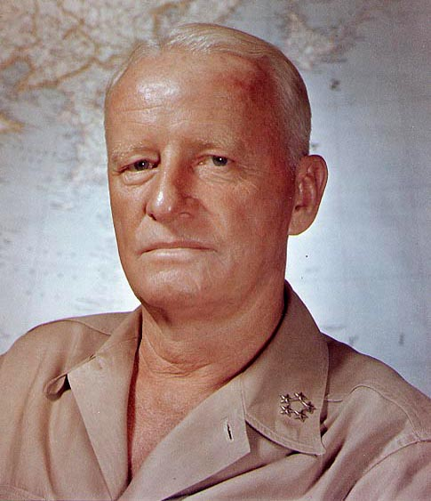
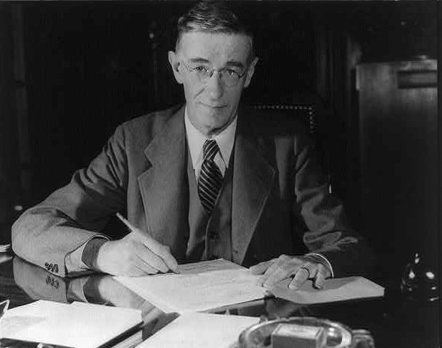


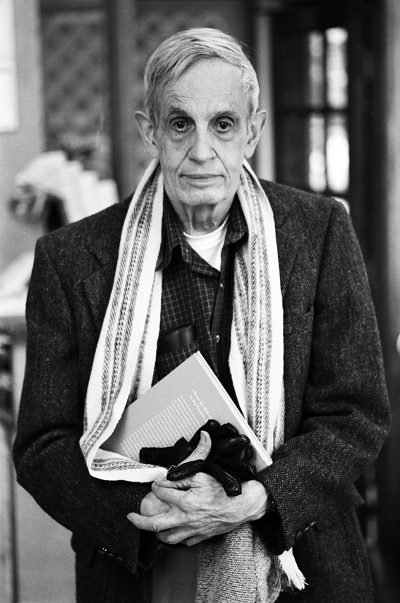

Idea: Computers are Feasible and Valuable
Won WWII
Tons of
Money
Tech Revolution
1930-1970
Notes:
Chester Nimitz, John Von Neumann

Slide 26



Idea: Computers are Feasible and Valuable
Won WWII
Tons of
Money
Tech Revolution
1930-1970

Slide 27







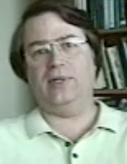
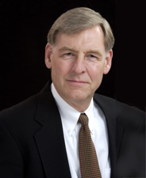
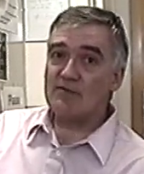
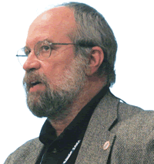
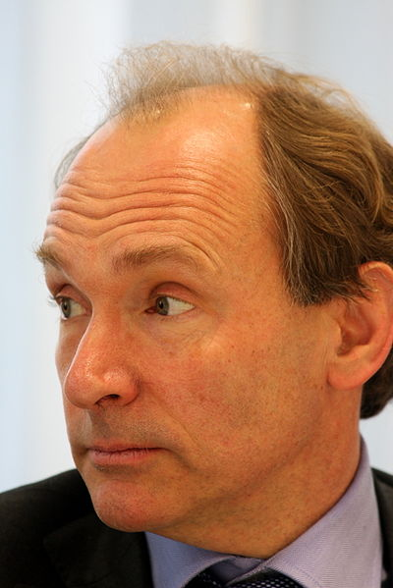
Research
Money
Idea: Networks are Feasible and Valuable
Solutions to
Problems
Open
Source
Network Revolution
1970-2000

Slide 28
The Present

Slide 29





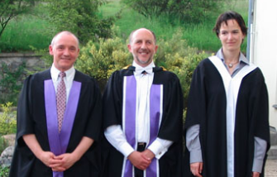

Government
Ideas
Ideas
Research
Money
????
Ideas
Ideas
Globalization
2000-2012

Slide 30

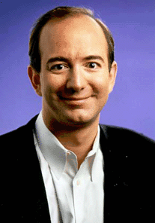
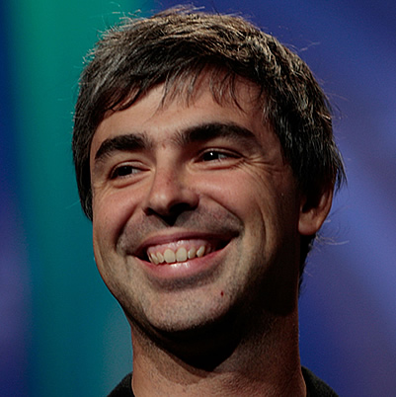
Government
Ideas
Ideas
Research
Money
????
Ideas
Ideas
Globalization
2000-2012

Slide 31
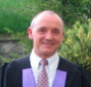
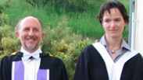
Government
Ideas
Ideas
Funding Agencies
????
Ideas
Editorial
Boards
Funding
Panels
Journals
Research
Funds
The "Engine" of Research
Tenure

Slide 32
Seeing little or no value coming back from higher education research or teaching funding, and a worsening first-world economy, governments are making unprecedented cuts in HE funding.

Slide 33

The Future

Slide 34
Education for the Wealthy Few
0000-1930
Graduates
Graduates
Research / Ideas
Gifts
Basic Funds
Gifts
Basic Funds

Slide 35
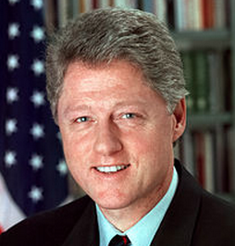
Education 2020 and Beyond
Graduates
Graduates
Research / Ideas
Gifts
Basic Funds
Gifts
Basic Funds

Slide 36


Slide 37
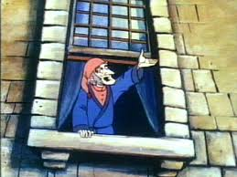
The Future is not pre-determined!

Slide 38
Government
Ideas
Ideas
Research
Money
????
Ideas
Ideas

Slide 39

Government
Ideas
Ideas
Ideas
Ideas
Journals?

Slide 40
Government
Ideas
Ideas
Money
Great
Students
Ideas
Ideas
Ideas
Ideas
Great
Students
Money

Slide 41
Guiding Principles
Market yourself! Be confident.
Give your ideas freedom - the are less valuable than you think
Real-world impact must become the goal of research
Tenure is about being well-known,widely respected and highly valued
Work on things that you are passionate about - change the world

Slide 42
WARNING WARNING
The world changes slowly. These ideas are just examples to make you think. I am arrogant, cynical and fearless. Please do not apply these approaches to your career without consulting a professional.

Slide 43
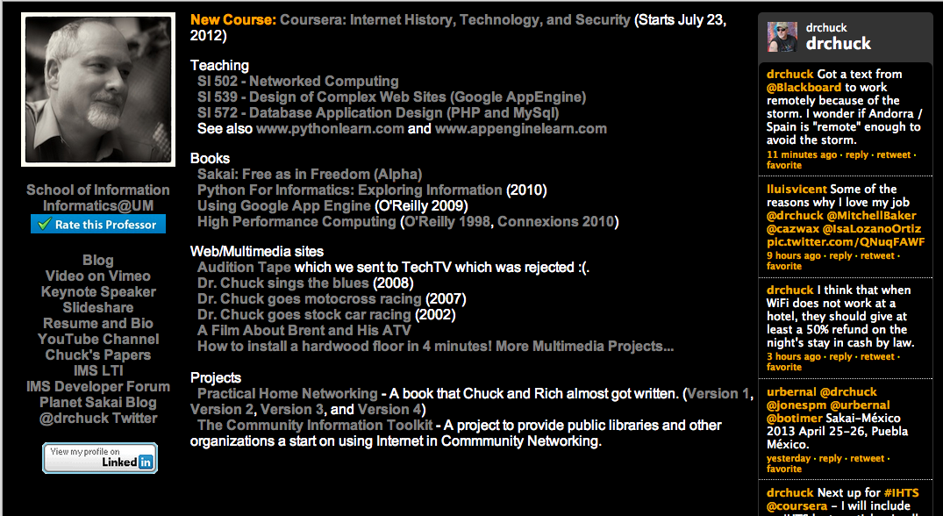
Create an Identity and Don't Be Shy

Slide 44
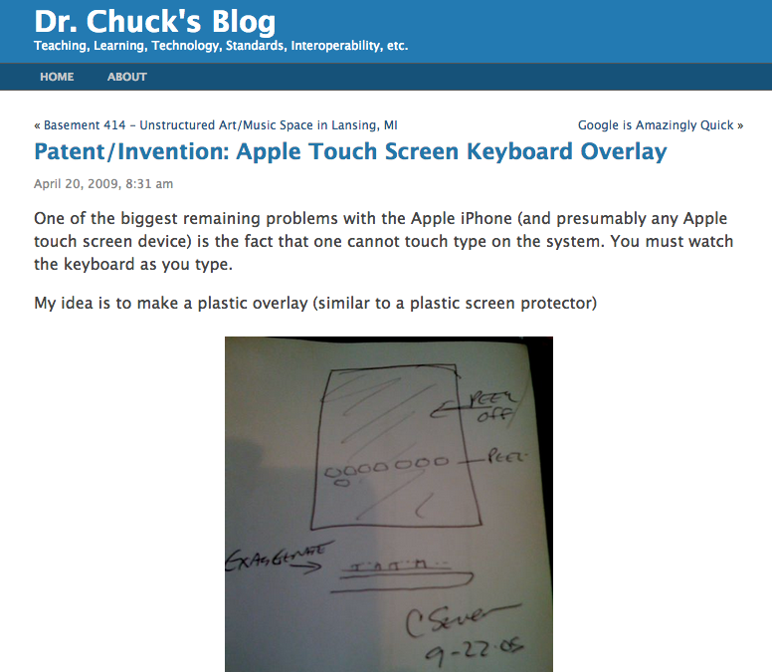
Truly share your good ideas. You are not likely to get rich - so at least make it so you can claim to be first.
Consider your blog a real publishing outlet.

Slide 45
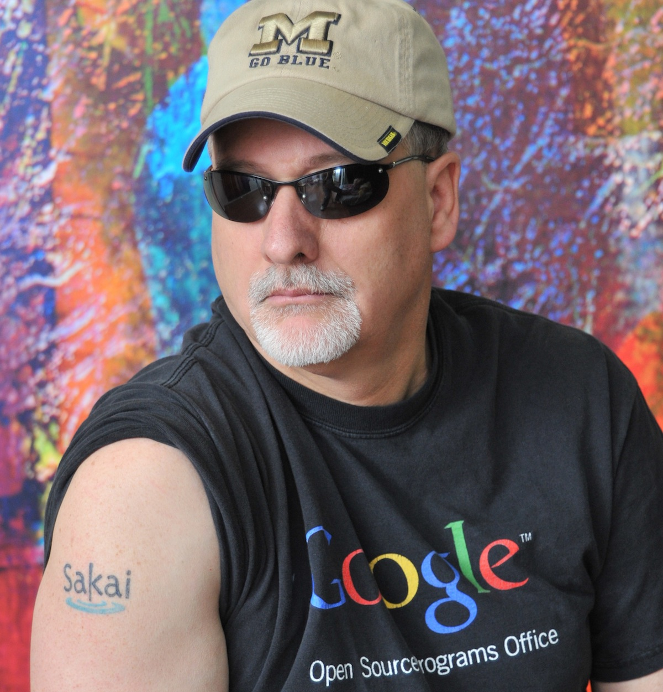


Slide 46
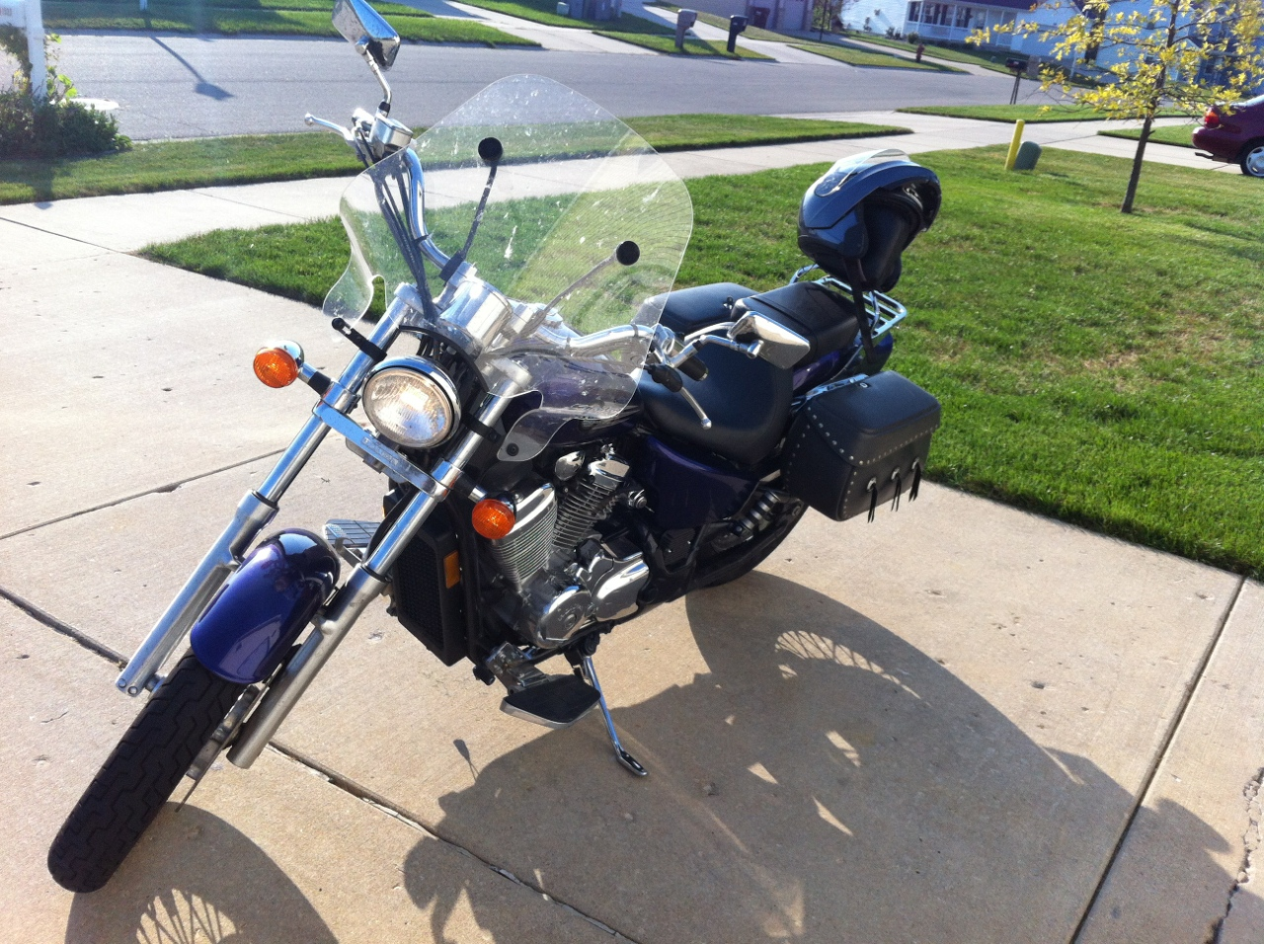
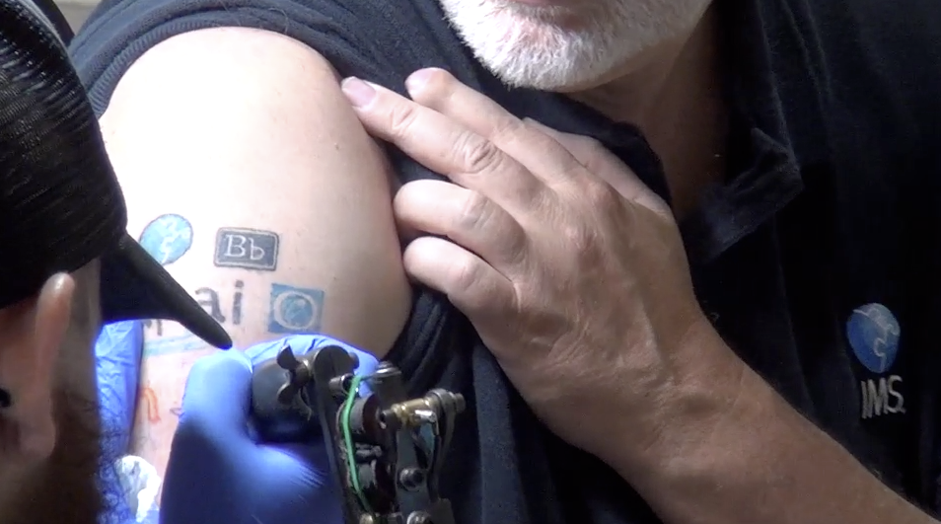
http://www.youtube.com/watch?v=VY-Ogkc7Mnw

Slide 47

http://www.youtube.com/watch?v=VY-Ogkc7Mnw

Slide 48


Slide 49



Slide 50










Learning Mangement System Plugins: 2005
LEARNING
TOOL OR CONTENT
:(

Slide 51


Tools
Interoperability
Commercial
Common
Cartridge
Publishers
LMS
Open Source
Standards
www.imsglobal.org

Slide 52












Slide 54



IMS LTI Nearly Universal in 2012
L T I

Slide 55


Dr. Chuck - Up in the Air

Slide 56

https://www.coursera.org/course/insidetheinternet

Slide 58


Slide 59


Slide 60

n=4701
Location
http://www.dr-chuck.com/coursera/insidetheinternet/2012-001/maps/where.html

Slide 61

n=4701
School
http://www.dr-chuck.com/coursera/insidetheinternet/2012-001/maps/school.html

Slide 62



Slide 63



Text
New York NY, Los Angeles CA, Ann Arbor MI, Wilmington, NC, Chicago IL, Washington, DC, Memphis, TN, Seattle WA, Seoul, Barcelona
http://www.youtube.com/watch?v=JzNHvmSv8T

Slide 64



Slide 65
Perhaps my approaches
seem crazy...

Slide 66

Later that day, I receive a text message from an unknown 202 area code number:
You will soon work for me.
February 15, 2012

Slide 67


March 26, 2012

Slide 68

Government
Ideas
Ideas
Money
Ideas
Great
Students
Ideas
Ideas
Great
Students
Ideas
Money

Slide 69
Boundaries
Edges
Inside
Outside

Slide 70

We Need New Structures...
We need flexibility
Tenure must become more fluid
Innovative / entrepreneurial faculty must be supported
Education must lead to student value
Sometimes structures are too fossilized and we must build anew

Slide 71

Change the world through teaching...
Great
Students

Slide 72


????????

Slide 73


http://online.dr-chuck.com/

Slide 74
Thank you

